Slide 1
L11 Multi-core
Zonghua Gu, 2018
4/12/2018
Acknowledgement: some slides taken from UC Berkeley CS61C

Slide 2
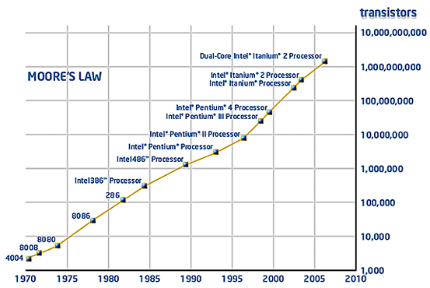
Moore’s Law
Number of transistors on a chip doubles every 18 to 24 Months
Notes:
the number of transistors that can be inexpensively placed on an integrated circuit is increasing exponentially, doubling approximately every two years
Patterson & Hennessy: number of cores will double every 18 months, while power, clock frequency and costs will remain constant

Slide 3
What to do with all the transistors?
Up to ~2005, CPU clock frequency had been increasing along with Moore’s law
Increased # transistors are used to design more sophisticated CPU (deeper pipelines, more complex control unit, super-scalar…)
But CPU clock freq stopped increasing after 2005
Highest CPU freq is ~4 GHz
Mainly due to power and heating issues

Slide 4
CPU clock freq stopped increasing
Power is proportional to CPU clock freq cubed (f³)
Power (W)
Pentium Tejas
cancelled!
Nuclear
Reactor
P4
STOP
P3
Pentium
P1
P2
Hot-plate
286
486
8086
386
8085
8080
8008
4004
Year

Slide 5
Motivation for multicore
# transistors on a chip is still increasing with Moore’s law; What to do with all the transistors now?
Instead of making a single-core faster by increasing its CPU clock frequency, put multiple (slow) cores on the same chip to increase overall chip performance with parallelism
Multicore processors!

Slide 6
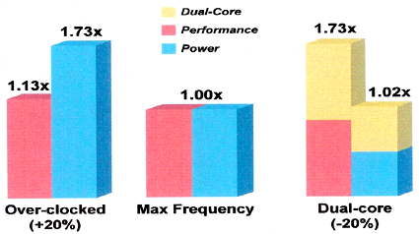
Performance vs. Power
Middle: Uni-core processor with standard clock freq (= f)
Left: Uni-core processor over-clocked 20% (clock freq = 1.2*f)
Higher performance (1.13x), but much higher power consumption (1.73x)
Right: A dual-core processor, with each core under-clocked 20% (clock freq = 0.8*f)
Higher performance (1.73x), with slightly higher power consumption (1.02x)
Notes:
Two or more processor cores on the same chip
Intel Core Duo processor
Semiconductor trends
More transistors available per die
Clock scaling reaching limits due to power constraints. An empirical study suggests that a 1% clock increase results in a 3% power increase.
Moore’s Law has hit a wall due to power constraints

Slide 7
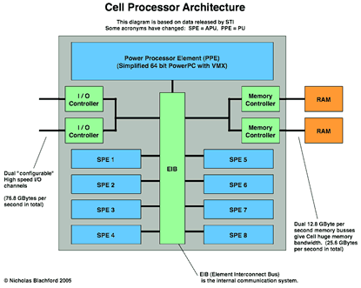
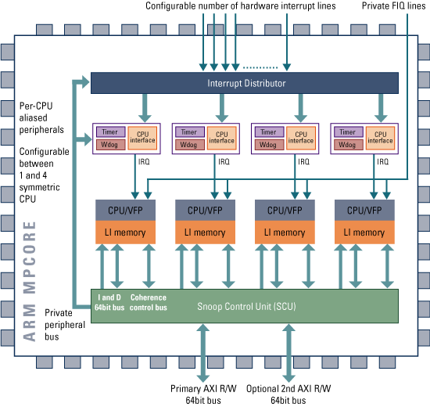
Homogeneous vs Heterogenous Multicores
ARM’s MPCore
IBM Cell Processor
4 identical ARMv6 cores
One Power Processor Element (PPE)
8 Synergistic Processing Element (SPE)

Slide 8
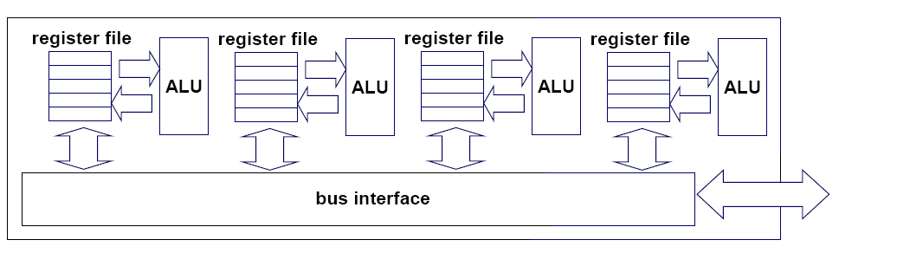
Multi-core architectures
This lecture is about a new trend in computer architecture: Replicate multiple processor cores on a single die.
Core 1
Core 2
Core 3
Core 4
Multi-core CPU chip

Slide 9
Multi-core CPU chip
The cores fit on a single processor socket
Also called CMP (Chip Multi-Processor)
core
1
core
2
core
3
core
4

Slide 10
Threads on different cores run in parallel
thread 1
thread 2
thread 3
thread 4
core
1
core
2
core
3
core
4
Notes:
OS perceives each core as a separate processor
OS scheduler maps threads/processes to different cores

Slide 11
On each core, threads are scheduled by OS with time-slicing
several threads
several threads
several threads
several threads
core
1
core
2
core
3
core
4
Notes:
OS perceives each core as a separate processor
OS scheduler maps threads/processes to different cores

Slide 12
Memory architectures
Shared memory
One common shared physical memory shared by all cores
Uniform Memory Access (UMA): all cores have the same memory access latency
Most common in embedded systems (focus of this course)
Distributed memory
Each core has its own local physical memory
Non-Uniform Memory Access (NUMA): longer latency for accessing remote memory than local memory
Only appears in large server processors
A manycore processor may have up to a few hundred cores

Slide 13
The memory hierarchy
L1 caches always private to each core
L2/L3 caches private in some architectures, and shared in others
Memory is always shared

Slide 14
Intel Xeon processors
hyper-threads
Dual-core Intel Xeon processor
L1 caches are private
L2 cache is shared
C O R E 1
C O R E 0
L1 cache
L1 cache
L2 cache
memory

Slide 15
Designs with private L2 caches
C O R E 1
C O R E 0
C O R E 1
C O R E 0
L1 cache
L1 cache
L1 cache
L1 cache
L2 cache
L2 cache
L2 cache
L2 cache
L3 cache
L3 cache
memory
memory
L1/L2 caches are private
Examples: AMD Opteron, AMD Athlon, Intel Pentium D
L1/L2/L3 caches are all private Example: Intel Itanium 2

Slide 16
Private vs shared caches
Advantages of private caches:
Better isolation and less contention among threads on different cores
Advantages of a shared cache:
Better sharing of cache space among threads on different cores: inter-thread communication can go through cache and not touch memory

Slide 17
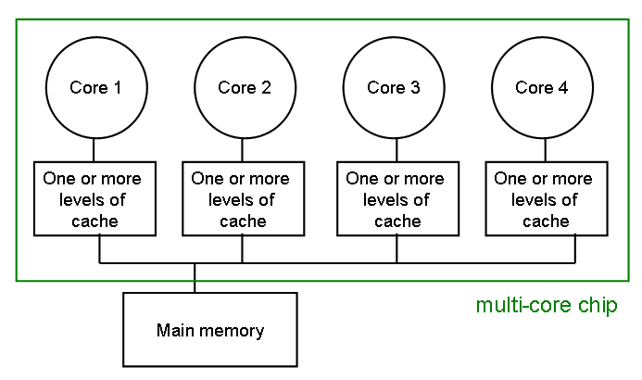
The cache coherence problem
Since we have private caches: How to keep the data consistent across caches on different cores?

Slide 18
The cache coherence problem
Suppose variable x initially contains 15213
Core 1
Core 2
Core 3
Core 4
One or more levels of cache
One or more levels of cache
One or more levels of cache
One or more levels of cache
multi-core chip
Main memory
x=15213

Slide 19
The cache coherence problem
Core 1 reads x
Core 1
Core 2
Core 3
Core 4
One or more levels of cache
x=15213
One or more levels of cache
One or more levels of cache
One or more levels of cache
multi-core chip
Main memory
x=15213

Slide 20
The cache coherence problem
Core 2 reads x
Core 1
Core 2
Core 3
Core 4
One or more levels of cache
x=15213
One or more levels of cache
x=15213
One or more levels of cache
One or more levels of cache
multi-core chip
Main memory
x=15213

Slide 21
The cache coherence problem
Core 1 writes to x, setting it to 21660
Core 1
Core 2
Core 3
Core 4
One or more levels of cache
x=21660
One or more levels of cache
x=15213
One or more levels of cache
One or more levels of cache
multi-core chip
Main memory
x=21660
assuming write-through caches

Slide 22
The cache coherence problem
Core 2 attempts to read x… gets a stale copy
Core 1
Core 2
Core 3
Core 4
One or more levels of cache
x=21660
One or more levels of cache
x=15213
One or more levels of cache
One or more levels of cache
multi-core chip
Main memory
x=21660

Slide 23
Cache coherence protocols
Many cache coherence protocols have been designed
We discuss a simple solution: invalidation-based protocol with snooping

Slide 24
Inter-core bus
Core 1
Core 2
Core 3
Core 4
One or more levels of cache
One or more levels of cache
One or more levels of cache
One or more levels of cache
multi-core chip
Main memory
inter-core bus

Slide 25
Invalidation protocol with snooping
Invalidation: If a core writes to a data item, all other copies of this data item in other caches are invalidated
Snooping: All cores continuously “snoop” (monitor) the bus connecting the cores.

Slide 26
The cache coherence problem
Revisited: Cores 1 and 2 have both read x
Core 1
Core 2
Core 3
Core 4
One or more levels of cache
x=15213
One or more levels of cache
x=15213
One or more levels of cache
One or more levels of cache
multi-core chip
Main memory
x=15213

Slide 27
The cache coherence problem
Core 1 writes to x, setting it to 21660
Core 1
Core 2
Core 3
Core 4
One or more levels of cache
x=21660
One or more levels of cache
x=15213
One or more levels of cache
One or more levels of cache
sends invalidation request
INVALIDATED
multi-core chip
Main memory
x=21660
assuming write-through caches
inter-core bus

Slide 28
The cache coherence problem
After invalidation:
Core 1
Core 2
Core 3
Core 4
One or more levels of cache
x=21660
One or more levels of cache
One or more levels of cache
One or more levels of cache
multi-core chip
Main memory
x=21660

Slide 29
The cache coherence problem
Core 2 reads x. Cache misses, and loads the new copy.
Core 1
Core 2
Core 3
Core 4
One or more levels of cache
x=21660
One or more levels of cache
x=21660
One or more levels of cache
One or more levels of cache
multi-core chip
Main memory
x=21660

Slide 30
Alternative to invalidate protocol: update protocol
Core 1 writes x=21660:
Core 1
Core 2
Core 3
Core 4
One or more levels of cache
x=21660
One or more levels of cache
x=21660
One or more levels of cache
One or more levels of cache
UPDATED
broadcasts updated value
multi-core chip
Main memory
x=21660
assuming write-through caches
inter-core bus

Slide 31
Invalidation vs update
Multiple writes to the same location
invalidation: only the first time
update: must broadcast each write (which includes new variable value)
Invalidation generally performs better: it generates less bus traffic

Slide 32
Invalidation protocols
This was just the basic invalidation protocol
More sophisticated protocols use extra cache state bits
MSI, MESI (Modified, Exclusive, Shared, Invalid)

Slide 33
Assigning threads to the cores
Each thread/process has an affinity mask
Affinity mask specifies what cores the thread is allowed to run on
Different threads can have different masks
Affinities are inherited across fork()

Slide 34
Affinity masks are bit vectors
Example: 4-way multi-core, without SMT
1
1
0
1
core 3
core 2
core 1
core 0
Process/thread is allowed to run on cores 0,2,3, but not on core 1

Slide 35
Default affinity mask
Default affinity mask is all 1s: all threads can run on all processors
The OS scheduler decides what threads run on what core
detects skewed workloads and performs load balancing on multiple cores

Slide 36
Soft affinity
Thread migration between cores is costly
The execution pipeline is stopped on the old core, and restarted on the new core
The private cache on the new core is “cold” and needs to be “warmed up”
Therefore, OS scheduler tries to avoid migration as much as possible
It tends to keeps a thread on the same core
This is called soft affinity

Slide 37
Hard affinity
If necessary, the programmer can programmatically prescribe hard affinities
Example use cases:
If multiple threads share data and communicate frequently, then map them to same core for more efficient communication
If a thread has hard and tight timing constraints, e.g., it runs a real-time robot controller, then assign it to its own dedicated core, and disallow migration of other threads to this core

Slide 38
Linux kernel API for hard affinity
#include <sched.h>
int sched_getaffinity(pid_t pid, unsigned int len, unsigned long * mask);
int sched_setaffinity(pid_t pid, unsigned int len, unsigned long * mask);
Kernel APIs for getting and setting hard affinities
len=sizeof(unsigned int long)

Slide 39
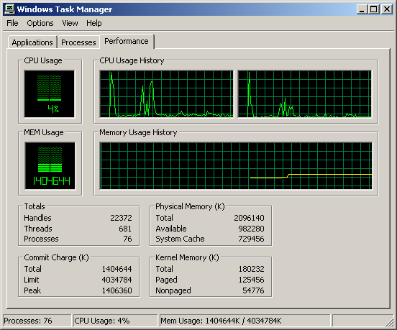
Windows Task Manager
core 2
core 1

Slide 40
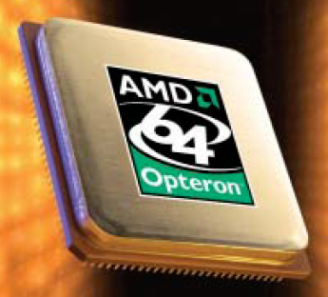
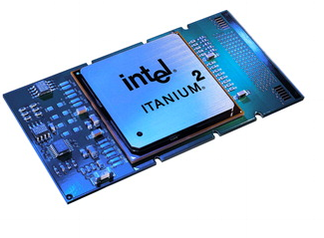
Conclusion
Multi-core chips an important new trend in computer architecture
Several new multi-core chips in design phases
Parallel programming techniques likely to gain importance

